Slide 1
FPGA implementation of an HDMI converter for serial high speed transmission
Marisa Oliveira
Master Thesis in Electrical and Computer Engineering

Slide 2
Content
Project Overview
Motivation
Equipment Used
Goals
Project Development and Results
Step 1
Generate and transmit COLOR BAR in FPGA to HDMI source
Simple communication of image between HDMI devices
Simple communication of image and sound between HDMI devices
Step 2
Serial communication of a Color Bar Image generated in FPGA and HDMI source
Serial communication of image between HDMI sink and source
Future Work

Slide 3
Project Overview

Slide 4
Project Overview
Motivation
Need for High Speed Connections VS Multimedia Interface Security

Slide 5


Project Overview
Motivation
Need for High Speed Connections
VS
Multimedia Interface Security

Slide 6
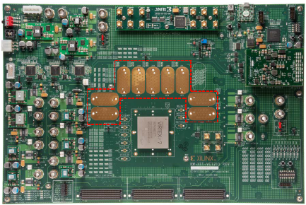
Project Overview
Equipment Used
FPGA VC7203
“Field-Programmable gate array”
Programmable device to develop and implement design
FMC connectors: transmit parallel data with a data rate up to 2 Gb/s (per channel)
GTX transceivers : transmit serial data up to 12,5 Gb/s
GTX transceivers
FMC connectors

Slide 7
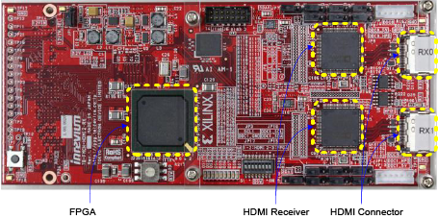
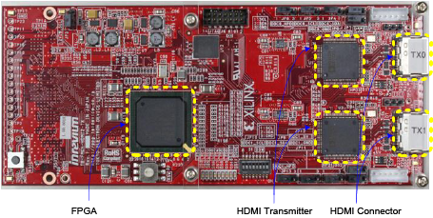
Project Overview
Equipment Used
TB-FMCH-HDMI2
Receiver (image above) and Transmitter (Image below)
Receive and transmit data from sink and source
Integrated FPGA with 3 different configurations available
Connection to VC7203 FPGA through FMC connectors
GTX transceivers

Slide 8
Project Overview
Goals
Obtain a reliable communication between two HDMI devices:
Connect HDMI sink device with HDMI receiver board through an HDMI cable
Implement a design in the FPGA to receive data from HDMI board
Create packets of the incoming data and send it to the GTX transmitter
Receive the incoming data from the GTX receiver and re-organize it
Finally send it again to the HDMI transmitter board
Connect HDMI source device through an HDMI cable to transmitter board

Slide 9
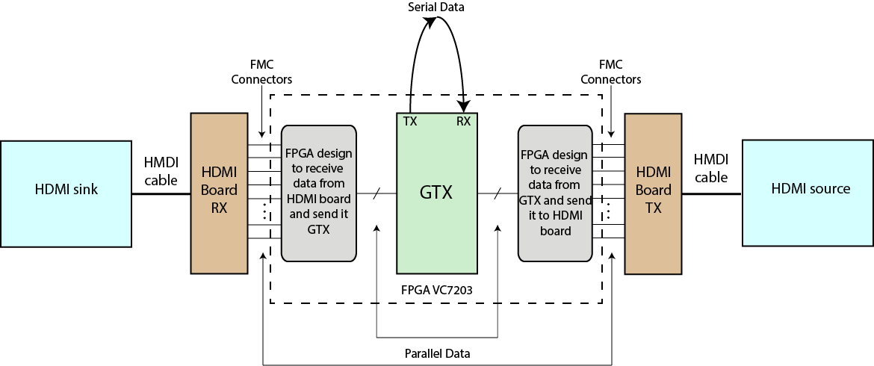
Project Overview
Goals
3
4
1
6
2
5

Slide 10
Project Overview
Goals
Goal
Step 1
Step 2
Project divided in two steps
Step 1: Obtain simple and direct communication between two HDMI exploring the boards different configurations
Step 2: Create a serial protocol and a design in the FPGA in order to connect data to GTX transceivers available in the FPGA

Slide 11
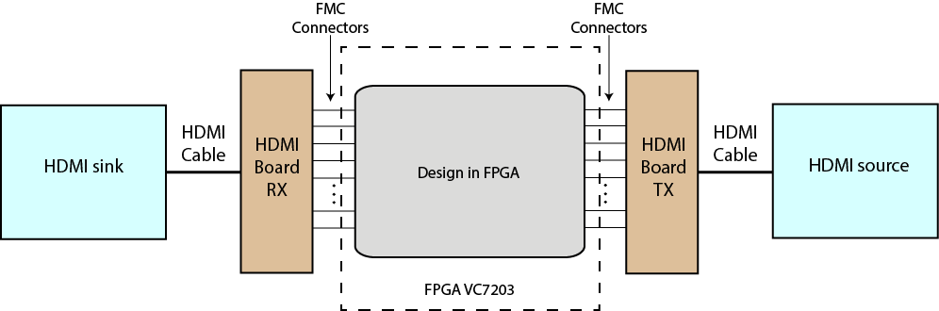
Project Overview
Goals – Step 1

Slide 12
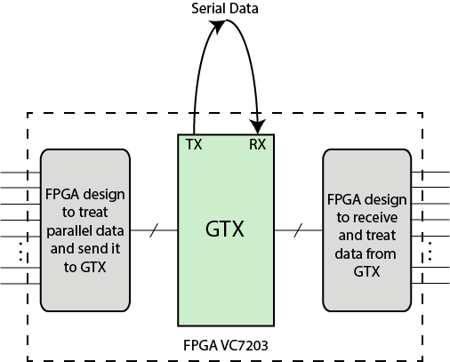
Project Overview
Goals – Step 2

Slide 13
Project Development
And some results

Slide 14
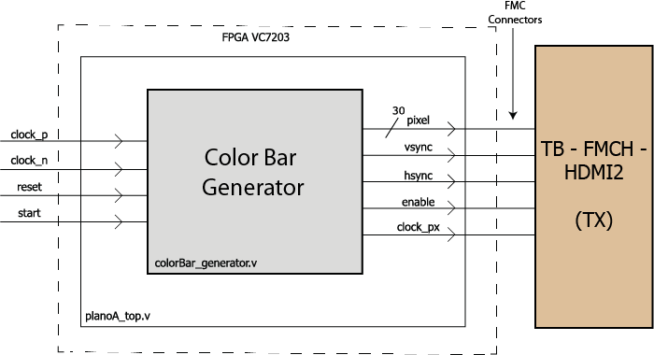
Step 1 – Development Generate and transmit COLOR BAR in FPGA to HDMI source
features
Design diagram
Generate a Color Bar in FPGA :
1920x1080 pixels
Refresh rate of 60 Hz
RGB images
10 bits for color
Control signals: vsync, hsync and enable
Pixel clock (148,5 MHz for FULL HD resolution)
Reset Button
To restart the whole system
Start Button
To star transmission of the color Bar

Slide 15
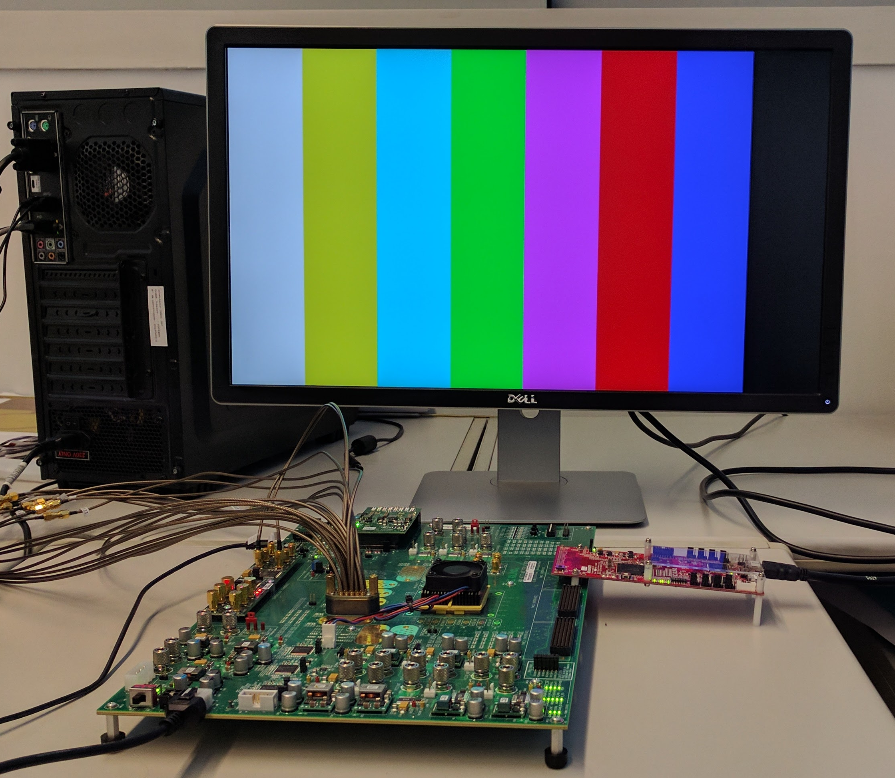
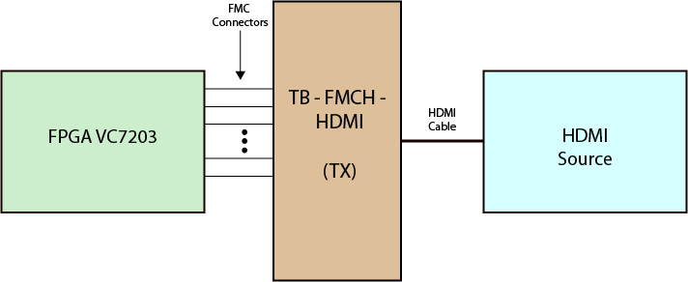
Step 1 – Results Generate and transmit COLOR BAR in FPGA to HDMI source
Test SETUP
Notes:
Resultados OK !!

Slide 16
Step 1 – Development Simple communication of image between HDMI devices
features
Generate a Color Bar in FPGA :
1920x1080 pixels
Refresh rate of 60 Hz
Transmit image from HDMI sink:
1920x1080 pixels
Refresh rate of 60 Hz
RGB images
10 bits for color
Control signals: vsync, hsync and enable
Pixel clock (148,5 MHz for FULL HD resolution)
Reset Button
To restart the whole system
Start Button
ON transmit Color Bar
OFF transmit image from HDMI sink

Slide 17
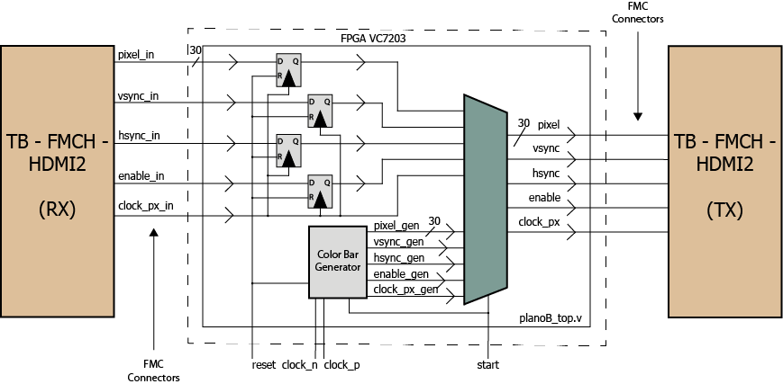
Step 1 – Development Simple communication of image between HDMI devices
Design diagram

Slide 18
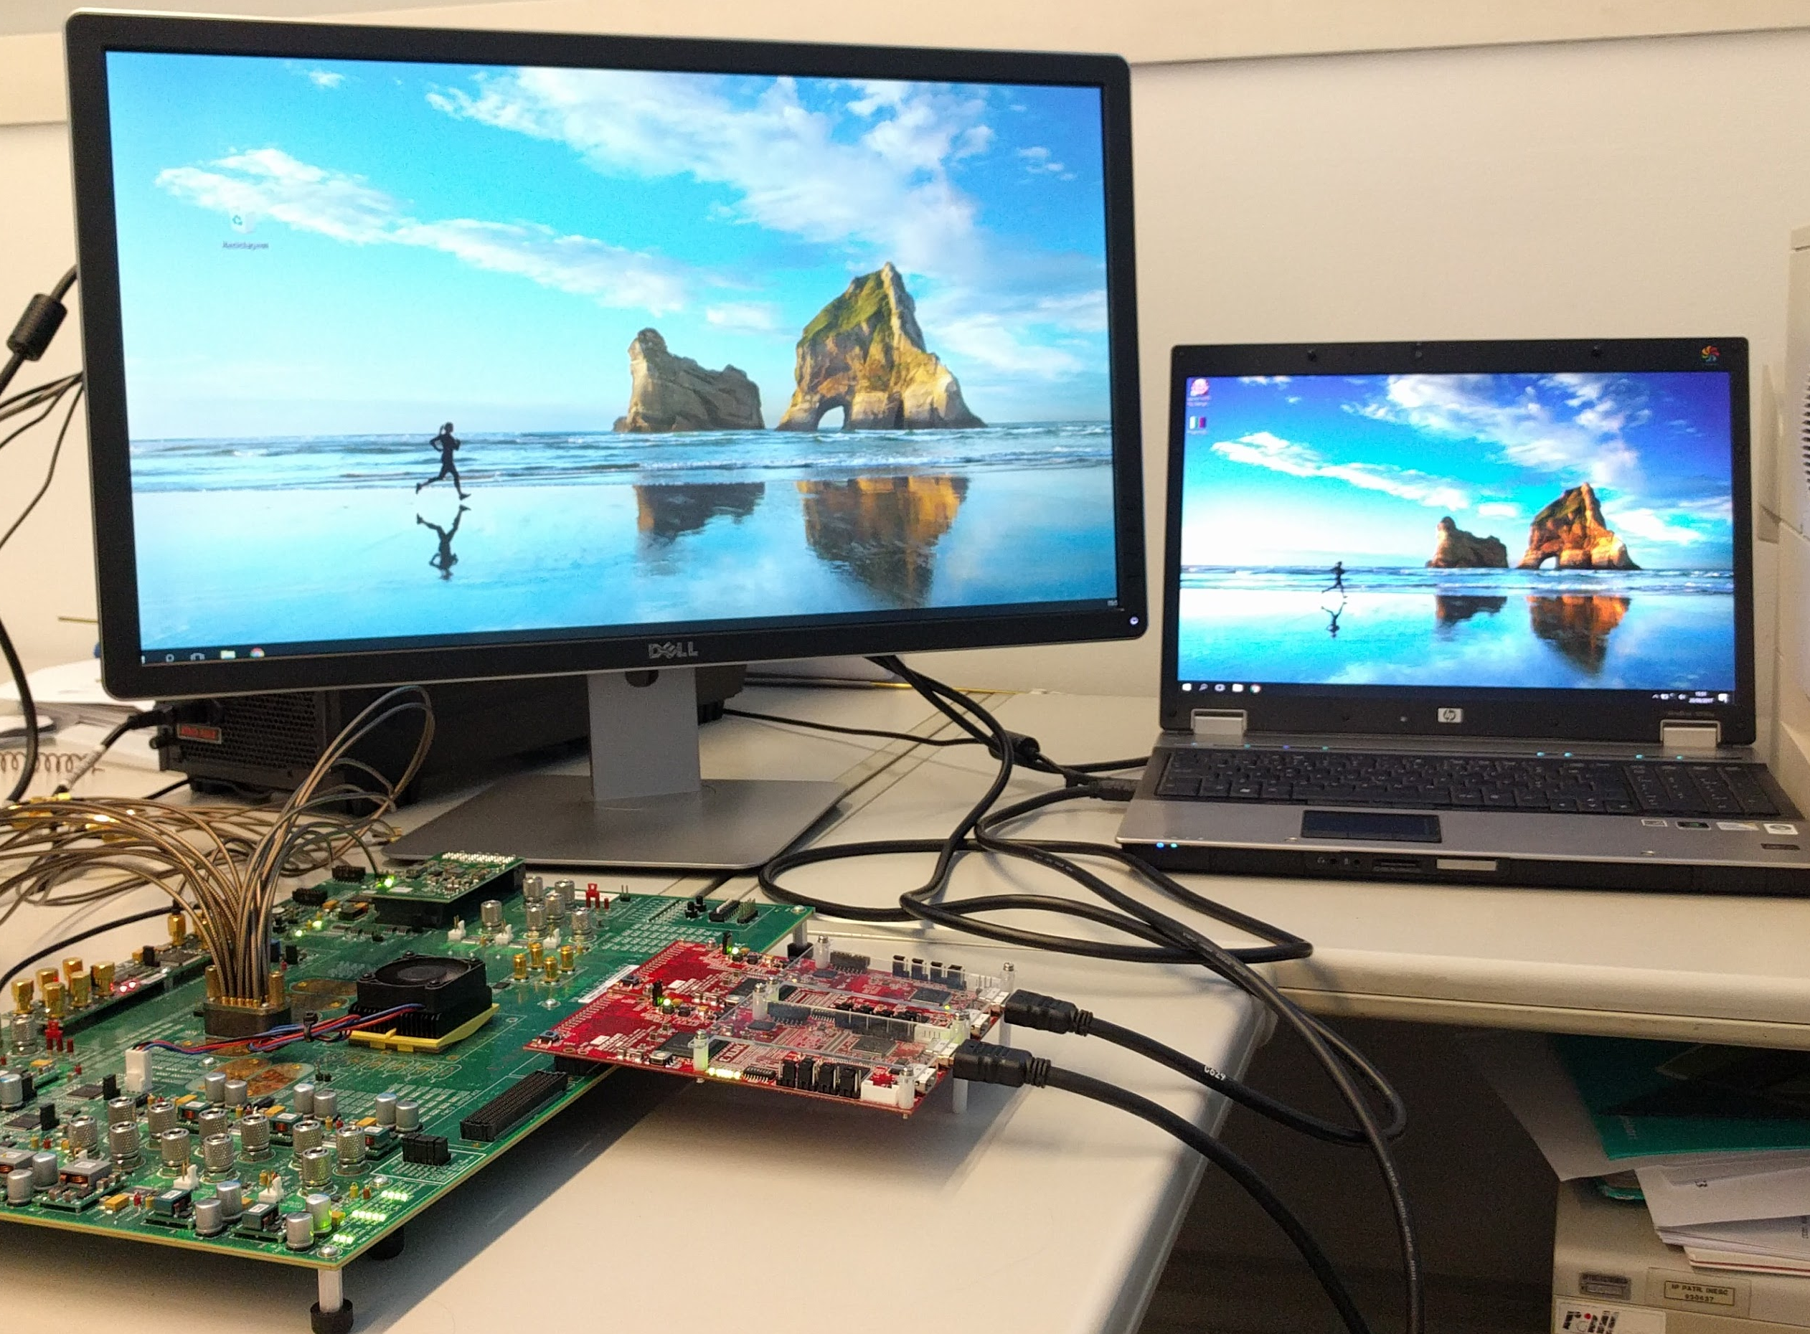
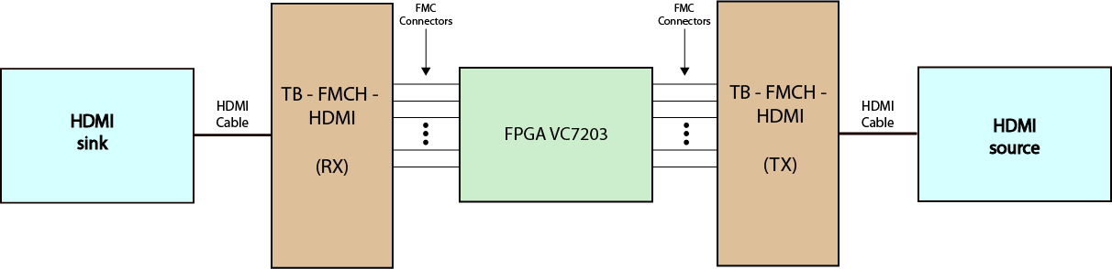
Step 1 – Results Simple communication of image between HDMI devices
Test SETUP

Slide 19
Step 1 – Development Simple communication of image between HDMI devices

Slide 20
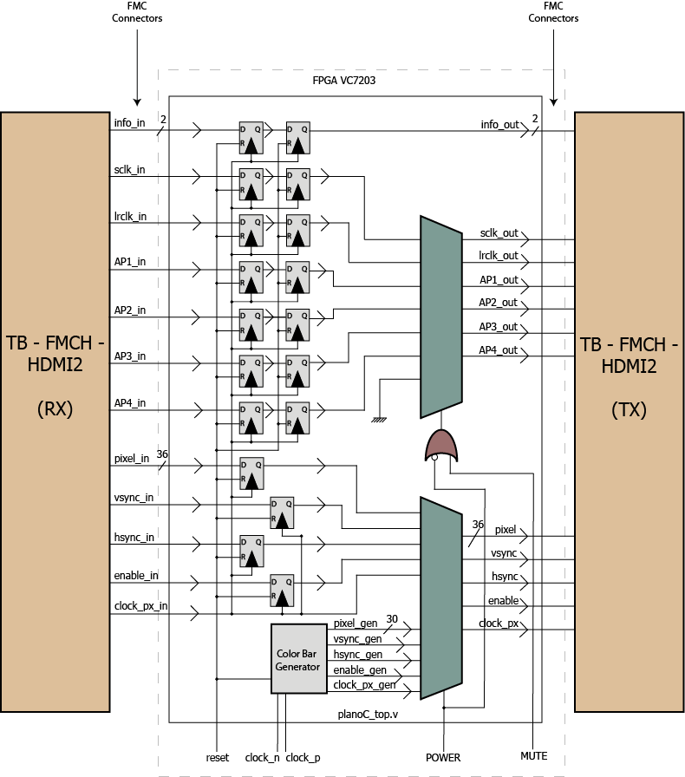
Step 1 – Development Simple communication of image AND SOUND between HDMI devices
Design diagram
Test SETUP

Slide 21
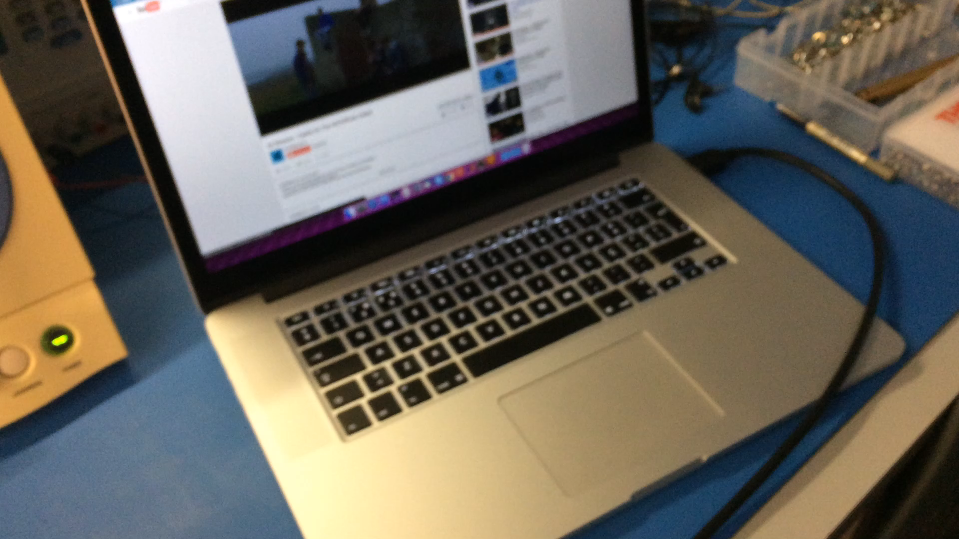
Step 1 - Results
Simple communication of image AND SOUND between hdmi devices

Slide 22
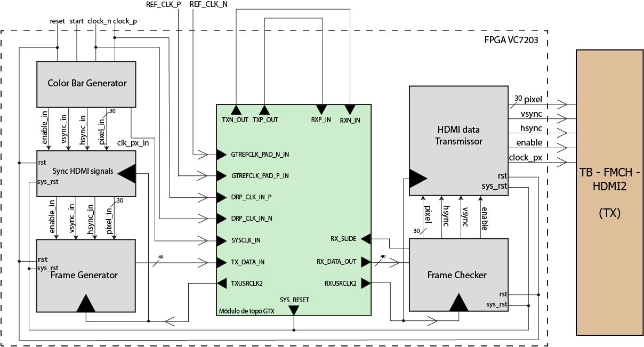
Step 2 - Development
Serial communication of COLOR BAR generated in FPGA and HDMI source

Slide 23
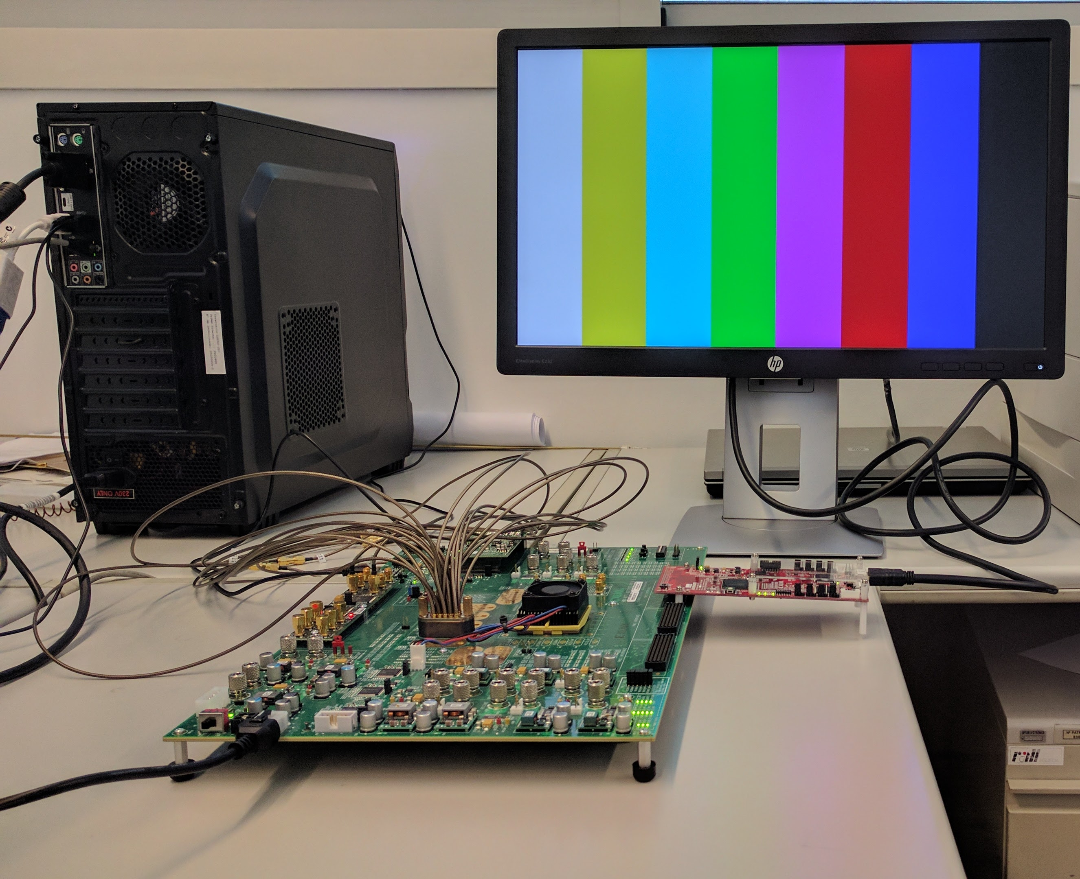
Step 3 - Results
Serial communication of a Color Bar Image generated in FPGA and HDMI source

Slide 24
Step 2 - Development
SERIAL COMMUNICATIAN OF AN IMAGE BETWEEN HDMI SINK AND SOURCE

Slide 25
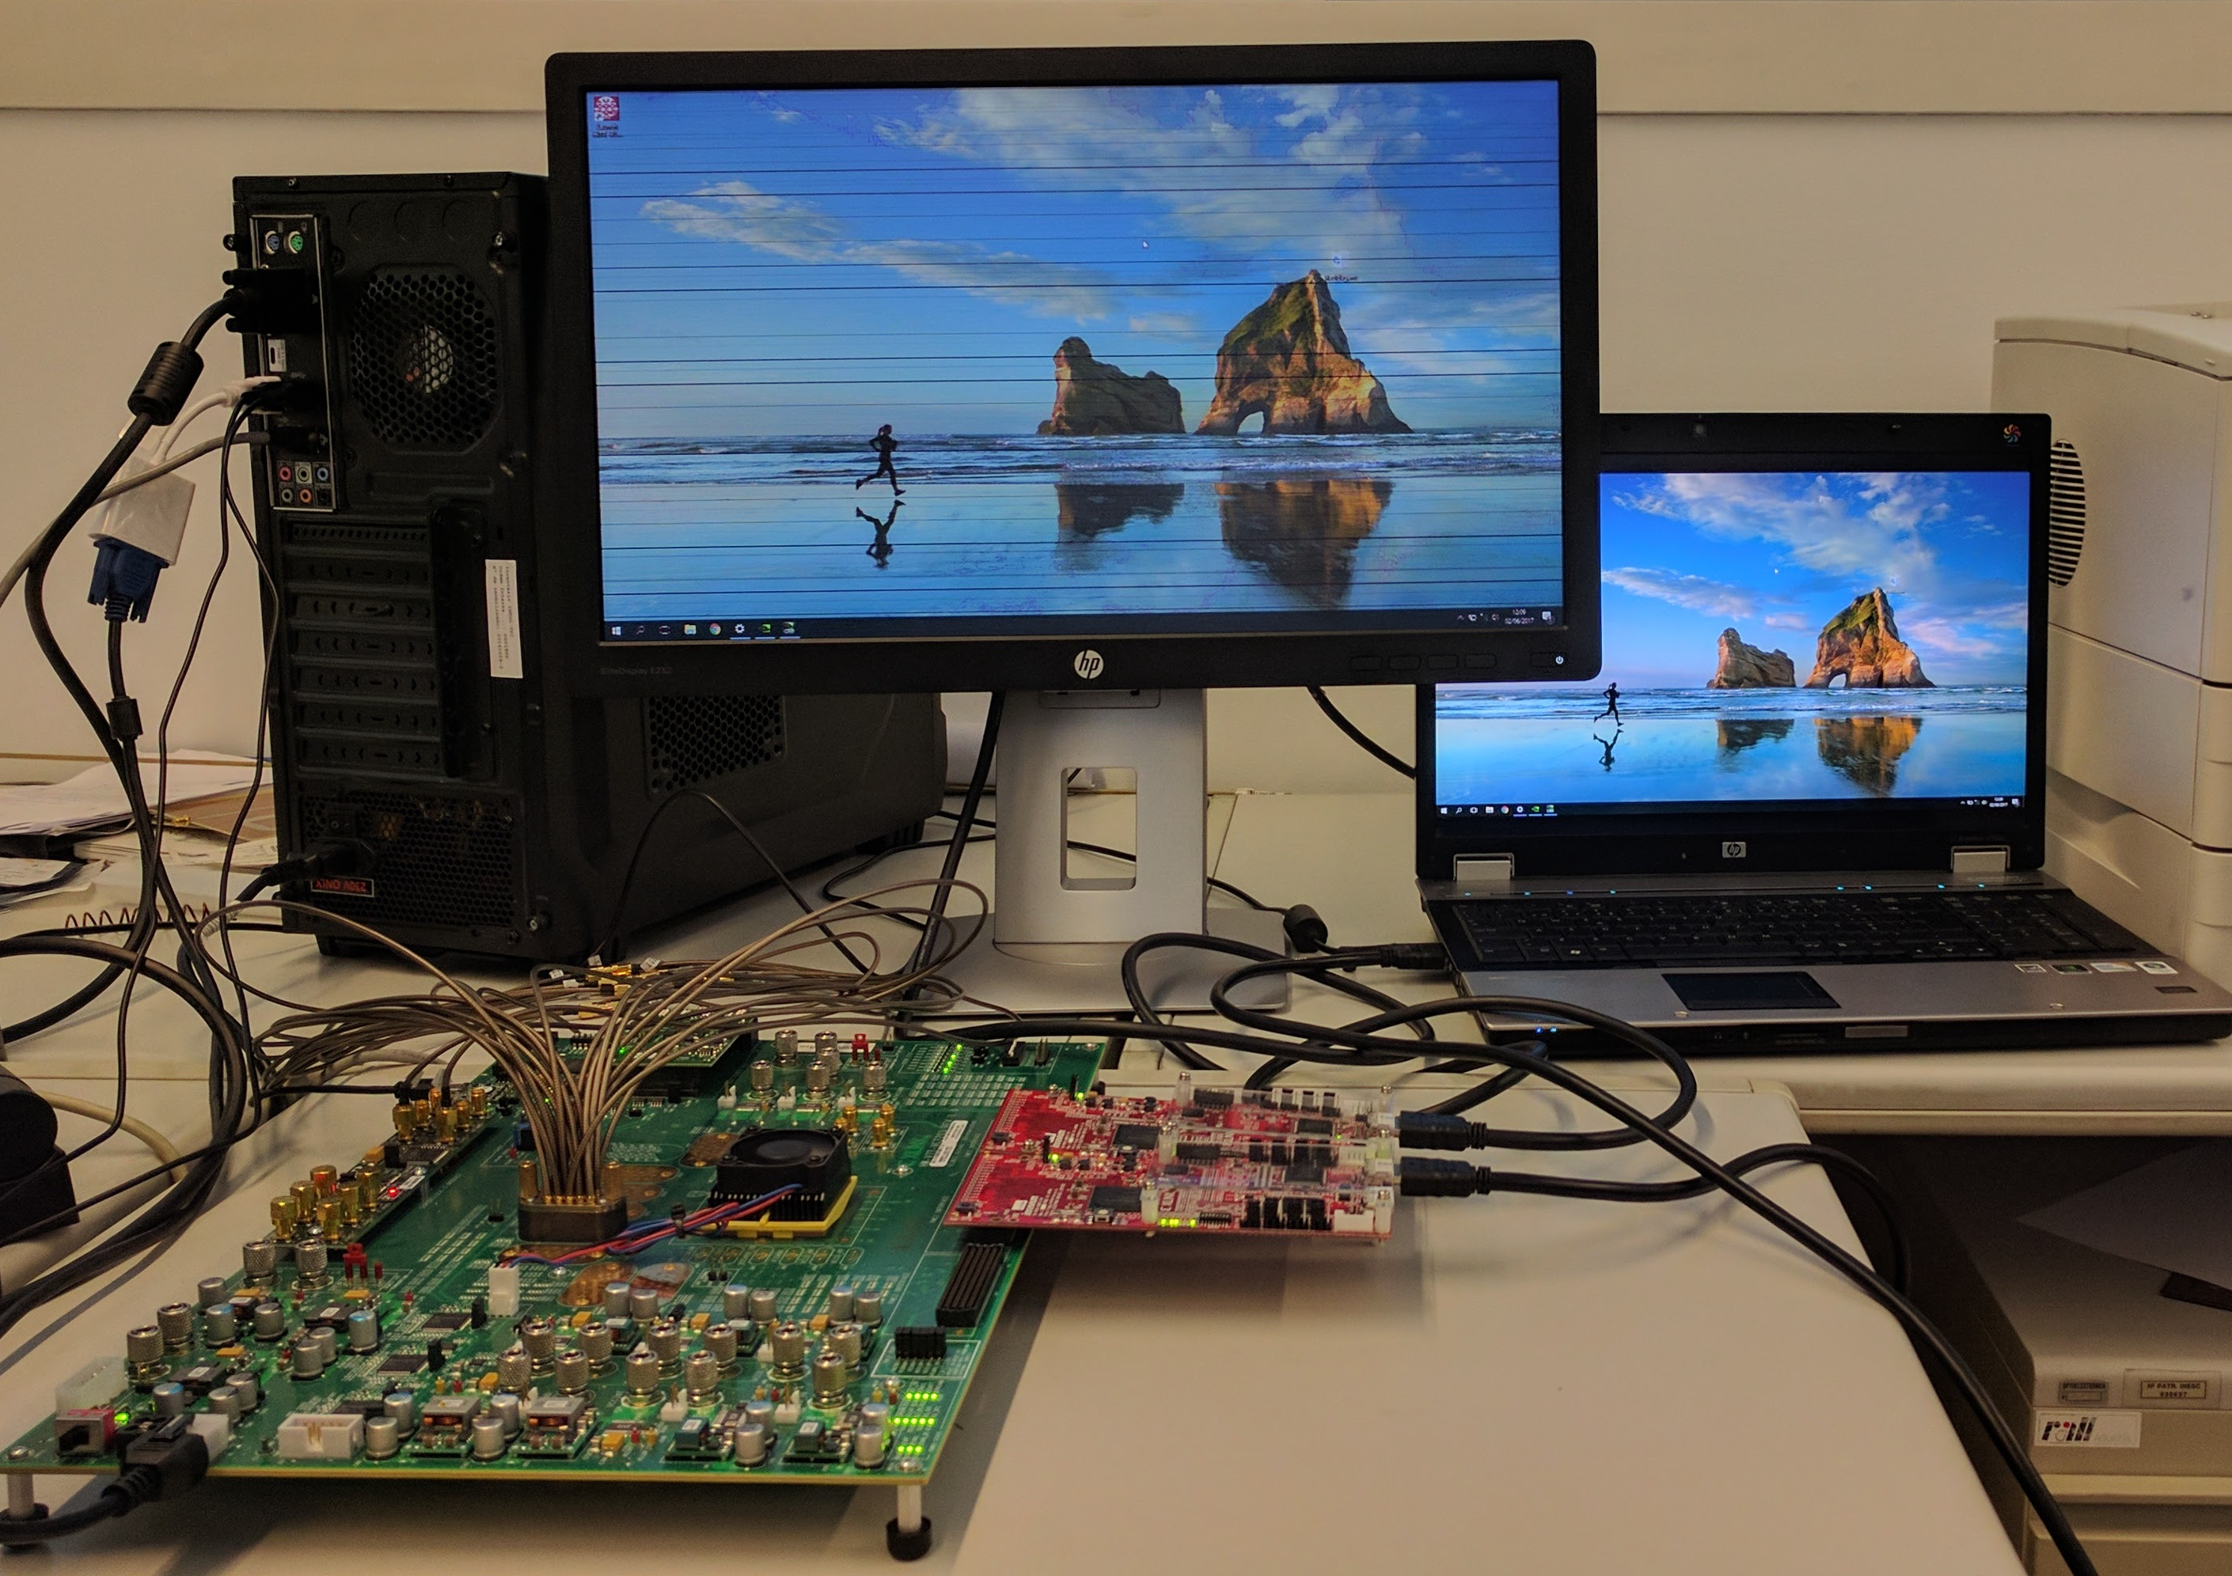
Step 2 - Results
SERIAL COMMUNICATIAN OF AN IMAGE BETWEEN HDMI SINK AND SOURCE

Slide 27
Conclusions
And future work

Slide 28
Add a Slide Title - 4

Slide 29
Thank you
Any Questions ?

